Slide 1
Official Statistics in the Age of Big Data
Michail SKALIOTIS
Eurostat
Ημερίδα
Στατιστικές και Μαζικά Δεδομένα (Big Data)
ΕΛΣΤΑΤ, Αθήνα, 9 Δεκεμβρίου 2016

Slide 2
This presentation
What is Official Statistics? Its role?
Overview of Big Data activities in the ESS
Selective issues about the statistical Office of the Future

Slide 3
Role of official statistics today?
'….To provide an indispensable element in the information system of a democratic society, serving the government, the economy and the public with data about the economic, demographic, social and environmental situation….'
[Fundamental Principles of Official Statistics; principle 1 on Relevance, impartiality and equal access]

Slide 4
Role of official statistics today?
Attention to quality, costs, burden on respondents, scientific principles, professional ethics, confidentiality
Exclusive use for statistical purposes
Presentation of information according to scientific standards on the sources, methods and procedures of the statistics
[Fundamental Principles of Official Statistics;
Principles 2,3,5,6]

Slide 5

A simpler definition
Statistics are the mirror through which we view society
David Hand @ Royal Statistical Society 2010

Slide 6

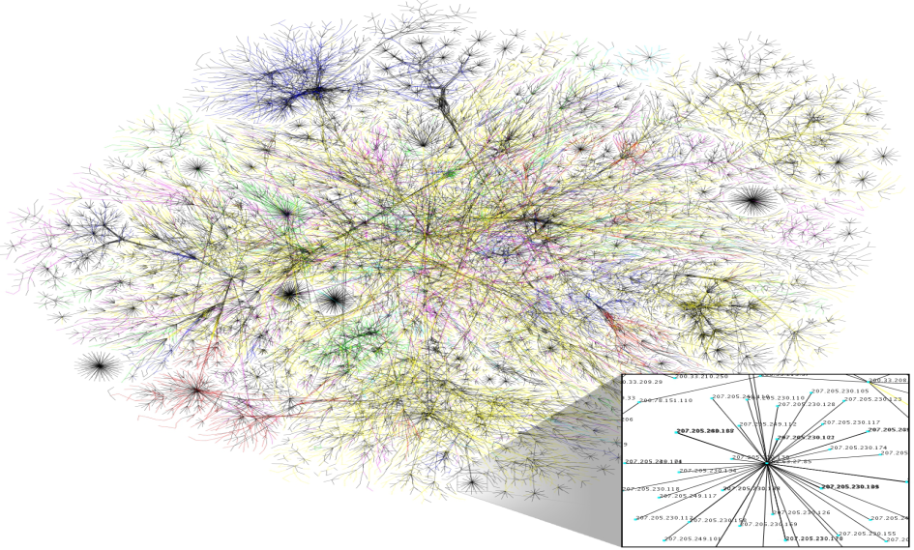






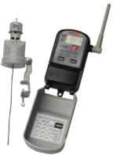





DRIVERS

Slide 7
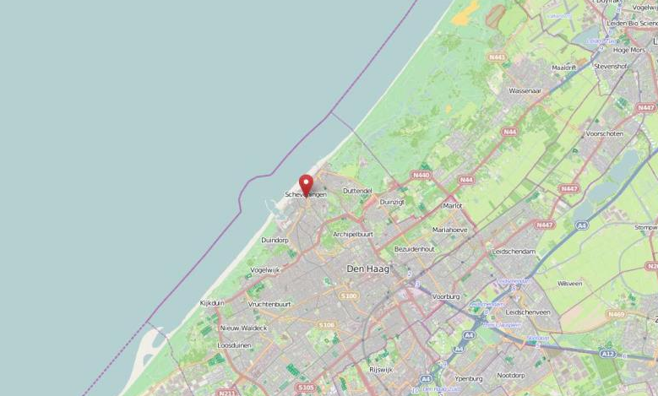

Big data action plan and roadmap for European official statistics
September 2013
Big data strategy
Roadmap
Heads of the National Statistical Institutes of the EU

Slide 8
Big Data Action Plan and Roadmap @ a glance
Governance
Policy
Quality
Skills
Experience sharing
Legislation
IT
Infrastructures
Methods
Ethics / Communication
Big data sources
Pilots

Slide 9
Governance
Policy
Quality
Skills
Challenges
cooperation, sharing of know-how
development of a sound methodology ("from design-based to model-based approach")
exploration & tentative implementation
Looking for partners
Experience sharing
Legislation
IT
Infrastructures
Methods
Ethics / Communication
Big data sources
Pilots
Action (example)
  Pilot projects, carried out by the Member States (ESSnet)
  2015 – 2019 (European Statistical System network)
  Exploring different big data sources (but also IT architecture, partnerships), developing generic guidelines and frameworks
  Establish Parternships with data providers and research and international organisations
  Cooperation with UN on Metodological Framework
Notes:
A first set of challenges refers to the cooperation and exchange of best practices, the methodology and the transition into the "real use" of data. These are perhaps the areas that are closest to a statistician's heart.
One way of tackling these issues, is the launching of a series of PILOT PROJECTS.
A Framework Partnership Agreement between Eurostat and 20 NSIs was signed in Nov 2015. In Dec 2015 Eurostat launched the Special Grant Agreements that will provide the resources to the NSIs to carry out the work.
In this context close cooperation between the ESS and the GWG will be necessary in order to avoid double work and ensure synergies between the two groups.
These pilot projects will be an important pillar of the big data activities in the ESS in the coming years and should pave the way towards a data production driven by big data.

Slide 10
Governance
Policy
Quality
Skills
Challenges
new skills for NSI staff: statisticians vs. data scientists ?
computing capacity, hardware ?
analytical tools, software?
storage ?
Experience sharing
Legislation
IT
Infrastructures
Methods
Ethics / Communication
Big data sources
Pilots
Action (example)
  Training program for European statisticians (ESTP)
  In the next years: dedicated courses on big data
  Focus on big data sources and on big data tools
  Acquiring the skills needed to assess sources and their quality, the skills to use tools and to explore big data sources
Notes:
Secondly, important enablers for a successful move towards big data, are SKILLS and IT INFRASTRUCTURE.
Our staff will slowly but steadily need new skills and our IT architecture & infrastructure will need to adapt to the new sources.
The impact on hardware needs will be significant. Experiments are ongoing, for instance the "sandbox" environment for big data experiments hosted by the Irish Central Statistics Office – in a cooperation between among others Eurostat and UNECE.
An concrete action in the pipeline, is the set-up of a series of training courses under the umbrella of the ESTP. Our Task Force on Big Data is currently preparing the outline for such program for 2016. The courses will focus on sources and on tools and will be modulated in a way to address basic/new users or management as well as more experienced users.

Slide 11
ESTP courses supporting big data (2016)
12 – 15 Sep
Big data sources - Web, Social media and text analytics
29 Feb – 2 Mar
21 – 24 Jun
Introduction to big data and its tools
Hands-on immersion on big data tools
Nowcasting
7 – 10 Nov
Advanced big data sources - Mobile phone and other sensors
5 – 7 Apr
8 – 10 Jun
24 – 26 Feb
The use of R in official statistics: model based estimates
Can a statistician become a data scientist?
Time-series econometrics
Big data courses
Methodology courses
Activity

Slide 12
Governance
Policy
Quality
Skills
Challenges
integrating official statistics in big data strategies
getting access to data & continuity of access
data security & privacy concerns
compensate for the burden ?
Experience sharing
Legislation
IT
Infrastructures
Methods
Ethics / Communication
Big data sources
Pilots
Action (example)
  Project on the analysis of legislation and strategy (but also ethics and communication)
  2015-2017 (22 months)
  Analysis for EU and for Member States at national level
  See also the Feasibility study on the use of mobile positioning data for tourism statistics (report on feasibility of access)
Notes:
Other important areas relate to the policy / political framework and the regulatory framework. Given the interaction between policy and regulation, it is very important to work on these areas in parallel and in narrow cooperation.
One aspect of policy will be the integrating of (official) statistics into any strategy related to big data. This is essential to put statistics on the map and to open doors to actually accessing of data. It should be kept in mind that big data are often held or stored by private companies, e.g. mobile network operator.
The discussion of access is not limited to the entry but should include a long term vision, in other words a certain continuity of access – this is a conditio sine qua non for a sound statistical system that is based, fully or partially, on big data sources.
A main barrier to access, is data security and privacy concerns –as was also highlighted in the feasibility study carried out with respect to tourism statistics.
Another important challenge is finding a sustainable business model for big data in official statistics, taking into account the budgetary impact for statistical offices and for those "holding" the data.
To address these questions, I can mention that Eurostat recently launched a Call for Tender with the objective of analysing the legal frameworks at EU and national level.

Slide 13
Governance
Policy
Quality
Skills
Challenges
transversal challenges to all big data activities: quality and ethics & communication
big data vs. statistics : "goodness of fit" (concepts, representativeness,…)
impact on the public opinion of privacy and security concerns ?
Experience sharing
Legislation
IT
Infrastructures
Methods
Ethics / Communication
Big data sources
Pilots
Action (example)
  Cooperation with UN on a quality framework for big data
  Project on the analysis of ethics and communication (but also legislation and strategy)
  2015-2017 (22 months)
  Analysis for EU and for Member States at national level
Notes:
As I already mentioned, all of the areas in the roadmap are interrelated.
Two areas in particular are of a more horizontal, transversal nature.
On the one hand "quality"… the quality framework as we know it, will not be adapted to the new data sources. Eurostat is contributing to the UN's work on a quality framework for big data.
Quality issues will appear in the pilots, when assessing the access to data, etc. Just think of conceptual issues (can statistical definitions be maintained when using big data?), timeliness and flexibility of access, coverage and sampling issues, etc…
On the other hand "ethics and communication" will play an important if not decisive role. Policy makers and businesses will be reluctant to cooperate or to launch big data initiatives if the "public opinion" is not supporting such approaches. Protection of data will become even more important than it already is now.

Slide 14

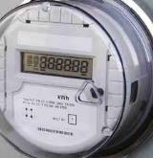

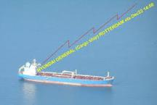
ESS Big Data Pilots
  List of pilot projects (Specific Grant Agreement)
  Web scraping
    job vacancies ; enterprise characteristics
  Smart meters
    electricity consumption ; temporary vacant dwellings
  Automatic Identification System (Ships)
    vessel identification data
  Mobile phone data
    Preparing for Access to data
  Scenario for using multiple inputs
Notes:
A first set of challenges refers to the cooperation and exchange of best practices, the methodology and the transition into the "real use" of data. These are perhaps the areas that are closest to a statistician's heart.
One way of tackling these issues, is the launching of a series of PILOT PROJECTS.
We hope to conclude a Framework Partnership Agreement very soon and will then launch the Special Grant Agreements that will provide the resources to the countries to carry out the work.
These pilot projects will be an important pillar of the big data activities in the ESS in the coming years and should pave the way towards a data production driven by big data.

Slide 15
Eurostat big data pilots
Contracts
  Feasibility study on the use of mobile phone data for tourism statistics
  Internet as a data source for information society statistics
  Accreditation of big data sources
Internal projects
  Wikipedia use
  Mobile phone for urban statistics
  Web evidence for nowcasting

Slide 16
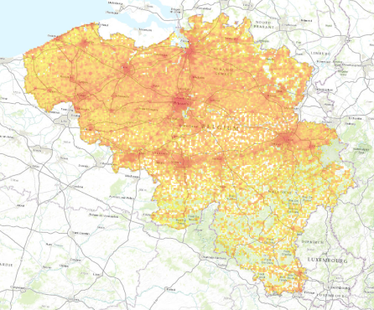
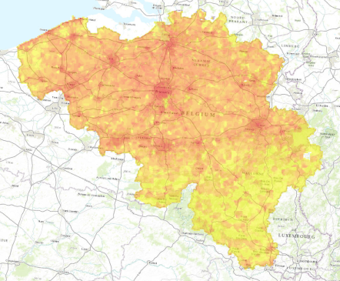
Mobile phone network data for population statistics (Belgium)
Census (2011)
Mobile phones (2015)

Slide 17
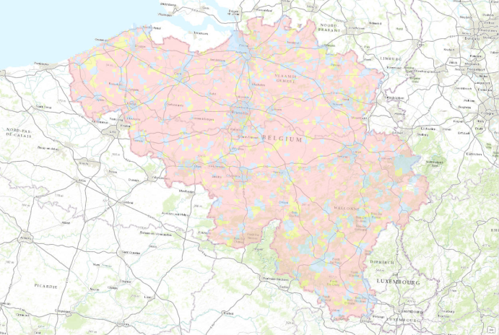
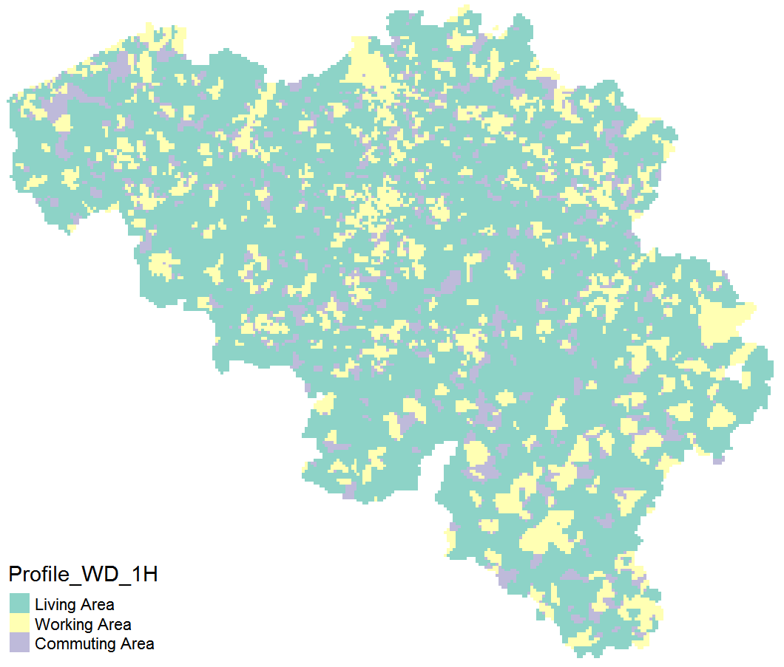
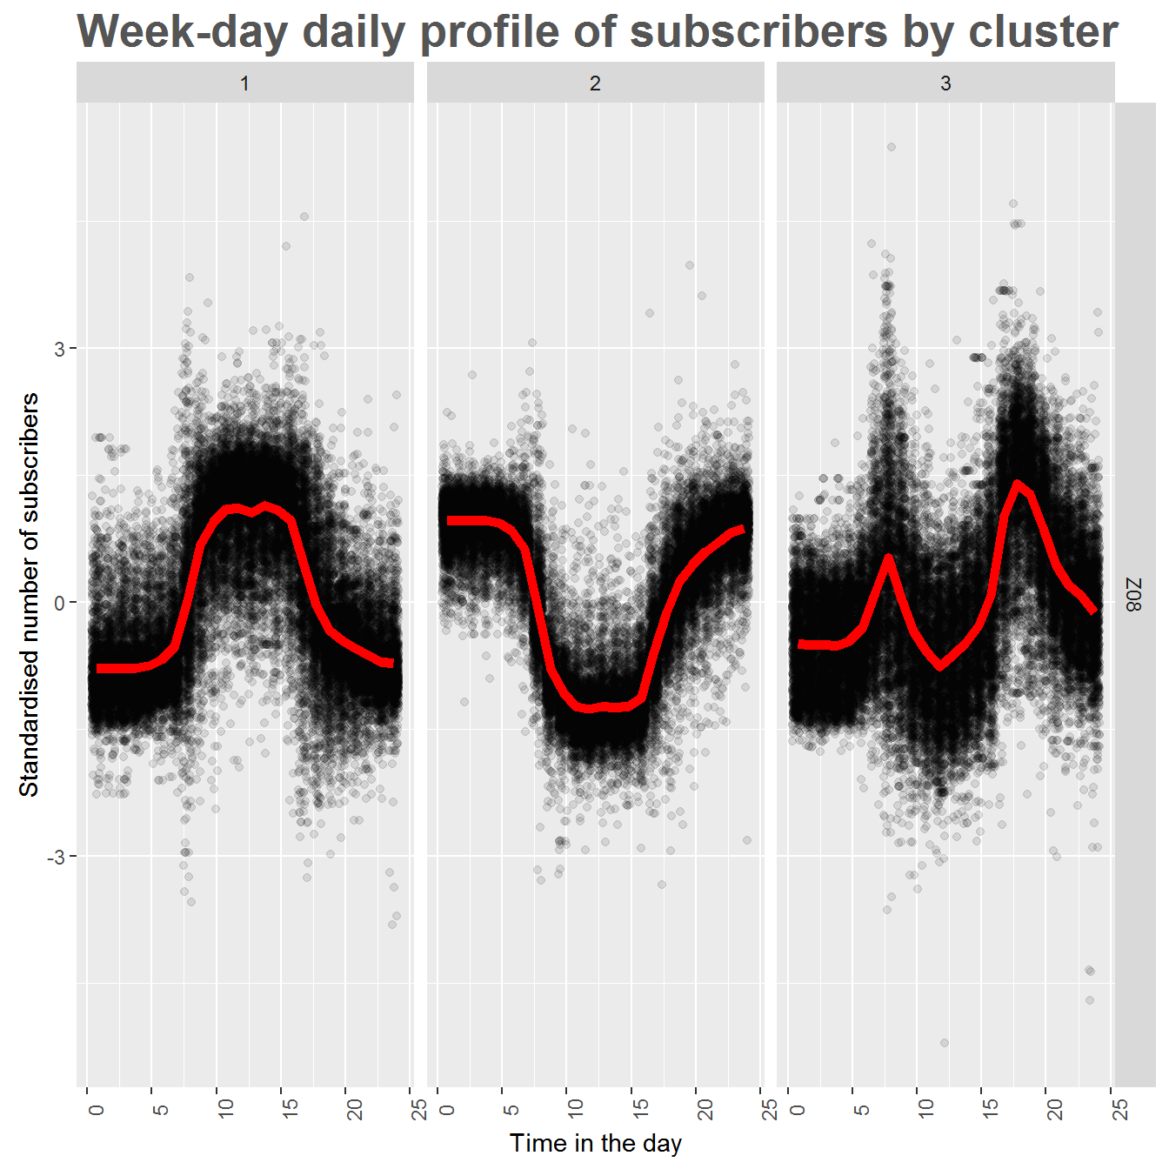
Mobile phone network data for automatic classification of territory

Slide 18
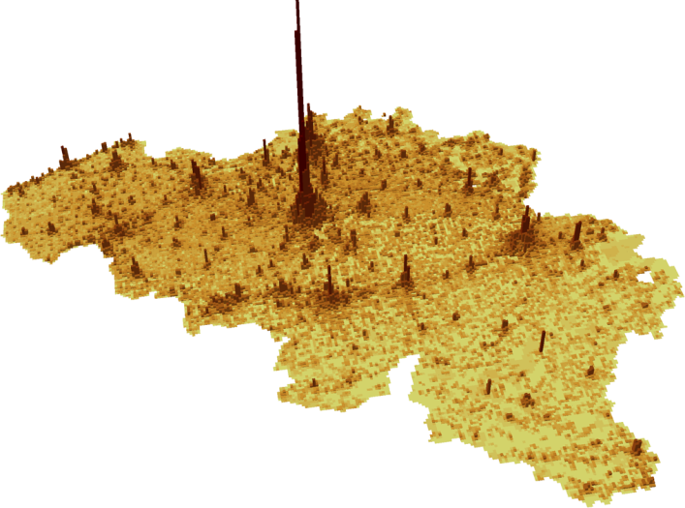
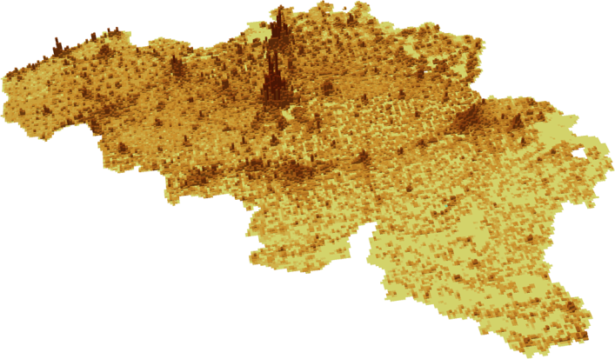


Population: at Night - at Noon
Where are people during a typical weekday, Thursday, 8 Oct 2015

Slide 19
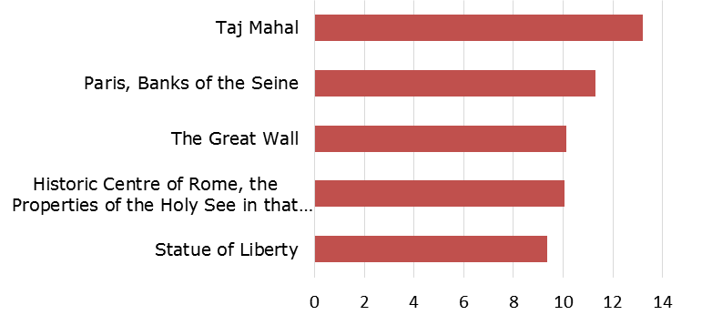
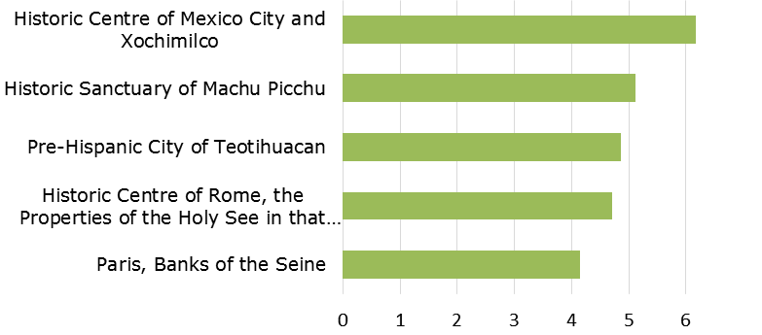
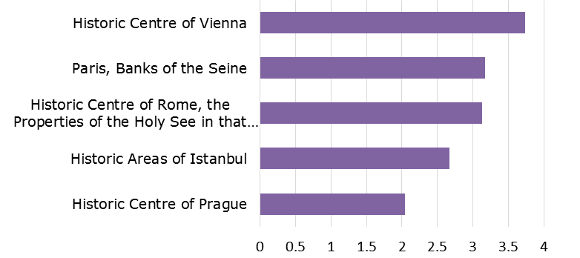
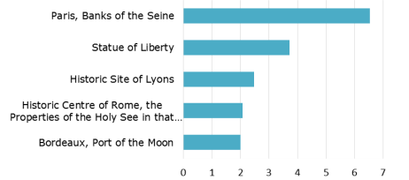
Top 5 WHS in number of page views of related Wikipedia articles by language
English
Spanish
German
French
Reference:
Jan.2012 – Oct.2015
31 languages

Slide 20
Challenges and Myths
Public understanding, perception and trust in statistics
The end of official statistics monopoly: are NSIs at risk of going out of business?
Big Data: the end of theory?
A changing role for official statistics?

Slide 21
Public understanding, perception and trust in statistics
We do have a serious gap
The privacy paradox: two opposite faces of trust
Communicating a value proposition for official statistics

Slide 22
Are NSIs driven out of business?
It will not be that easy…
Benchmarking
Request for information by government will persist
Unbeatable core values which underpin science, guide public policy and business decisions
But we need to embrace 'data science' as being part of 'greater statistics'
Business model for official statistics has to be adapted

Slide 23
What is changing in evidence-based policy making today?
Algorithmic Decision Making
on the Political Agenda in Europe and USA
EU: Data4Policy group in the European Commission
USA: Evidence-Based Policy Commission
This is not just another commission. It is part of a sea change in how we solve problems [Speaker Paul Ryan, July 26, 2016]

Slide 24
The end of theory…or better theory?
Scientific approach in the era of big data is needed more than ever before
Kirk Borne: Statistical Truisms in the Age of Big Data (19 June 2013):
-correlation does not imply causation
-sample variance and bias do not go to zero
-absence of evidence is not the same as evidence of absence
A great moment: revisit theory in the age of big data

Slide 25
A changing role for official statistics?
Accreditation and certification may become core tasks of NSIs
Statistical modelling will be a main activity
From descriptive indicators to nowcasting and forecasting
Re-thinking surveys and censuses in terms of reality mining: blending big data with tradition
It will be difficult to justify a 'traditional census of population' in the post2020 rounds

Slide 26
The statistical office of the future
What will be the impact of ubiquitous data collection and networking
  Internet of [every]Things,
  Cloud services,
  Wearables,
  Autonomous traffic,
  Smart systems,
  …
on official statistics?

Slide 27
The statistical office of the future
Data flows instead of surveys and censuses
Data customer instead of data provider
Product designers instead of data collection designers
New answers related to
  Quality and transparency
  Privacy and confidentiality
  Access to third party data sources / data sharing
  Scientific standards and methodology
  Professional ethics
  Skills
Accreditation and certification instead of production
Embedded in data flow – statistics 'everywhere'

Slide 28
Concluding remarks
Big Data is here to stay and … grow bigger
Embracing big data and data science into 'greater statistics' is the only way forward
We have much work to do !

Slide 29
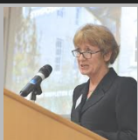
African proverb
When the music changes so does the dance
If we fail to listen we will be out of step
Professor Denise LIEVESLEY

Slide 30
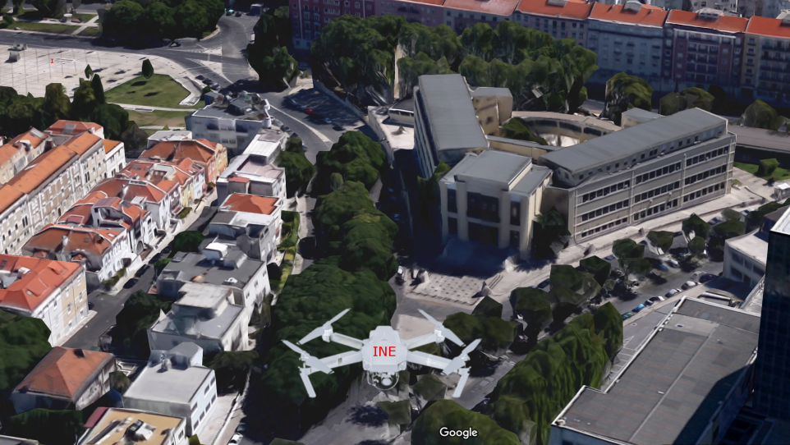
…drones…census of buildings…?
Thank You for your Attention

